Slide 1
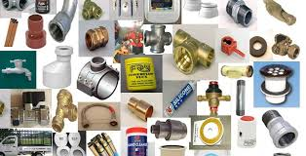
Plumbing Materials

Slide 2
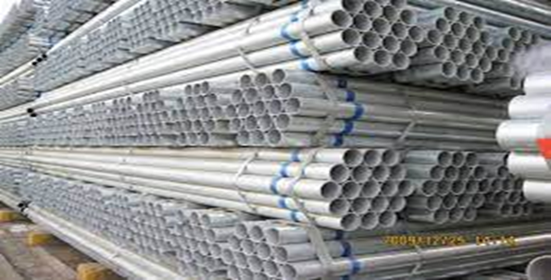
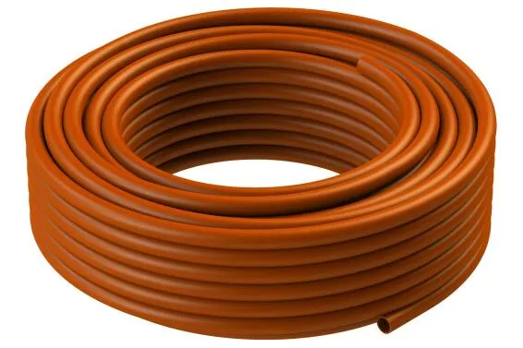
Materials
1. PCV pipes
-They are used as drainage and sewage pipes.
2. Pex pipes
- It is used to supply water.

Slide 3
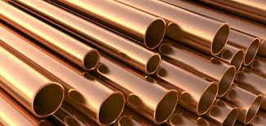
3. Copper pipes
- They are used for supplying water.
4. Galvanized pipes
- They are used for supplying water.

Slide 4
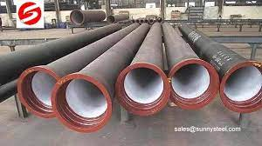
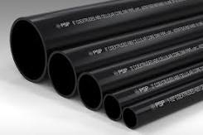
5. Cast iron pipes
- They are used for supplying water.
6. ABS pipes
- They are used for supplying water.

Slide 5
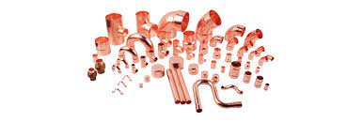
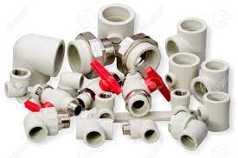
7. Copper fittings
- They are used for joining pipes.
8. Plastic fittings
- They are used for joining pipes.

Slide 6
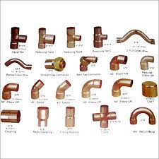
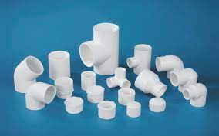
9. Copper fittings
- They are used for joining pipes.
10. Plastic fittings
- They are used for joining pipes.

Slide 7
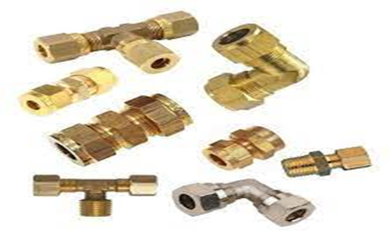
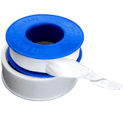
11. Brass fittings
- They are used for joining pipes.
12. Tread tape
- It is used to tight seal pipes and fittings..

Slide 8
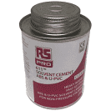
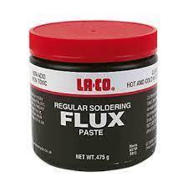
11. PVC glue
- It is used to tight seal pipes and fittings.
12. Flux
- It is used to remove oxide films.
Feedback
Activity : Worksheet 3

Slide 9


Kwa Thema Skills School
Subject : Maintenance Marks : 10
Grade : Year 2 Time : 30mins
Date :
Question:1
Give the purpose of the following.
1.____________________________ 2._____________________________
3.____________________________ 4. _____________________________

Slide 10

5. _________________
(5)
Question : 2
1.Name five types of pipes that are used in plumbing.
1.1 ____________________________
1.2 ____________________________
1.3 ____________________________
1.4 ____________________________
1.5 ____________________________
(5)
Total : 10

